Slide 1
End of Key Stage 1 Assessment
St Martin’s CE (Aided)
Primary School
Meeting For Parents and Carers
2nd March 2020

Slide 2
Teacher Assessment
At the end of Year 2, teachers make a teacher assessment judgement for every child for:
*English reading
*English writing
*Mathematics
*Science
It is the teacher assessment that is reported to parents and the DfE.
The test outcome supports the teacher assessment BUT is only one source of evidence the teachers use – they also use their professional knowledge of your child, their observations of your child and the work your child has completed in class.

Slide 3
Teacher Assessment
In June, teachers make an assessment of your child’s learning
In English reading, writing and maths:
Working towards age-related expectations
Working at age-related expectations
Working at greater depth within age-related expectations
To be assessed at age-related expectations, your child must be able to understand ALL KPIs (key performance indicators)
Science is assessed at Working at age-related expectations, or not. There is no indication of greater depth within age-related expectations

Slide 4
Building a picture of a child’s learning across the year
Ongoing assessment through class teaching…
What children say and do independently in class.
Written work from across the year in their book including practise tests.
Statutory Y2 national curriculum tests.
Teacher Assessment
Moderation school, cluster, county

Slide 5
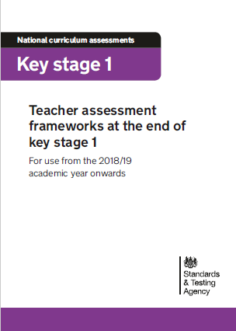
Teacher Assessment Frameworks
All Teacher Assessments are based on the Teacher Assessment Frameworks.

Slide 6
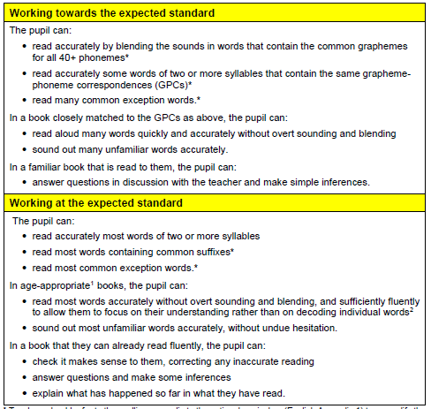
Teacher Assessment Framework for Reading.

Slide 7
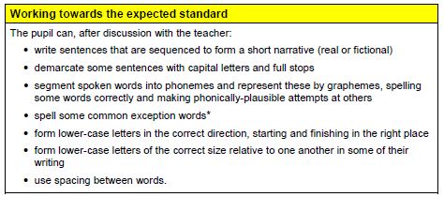
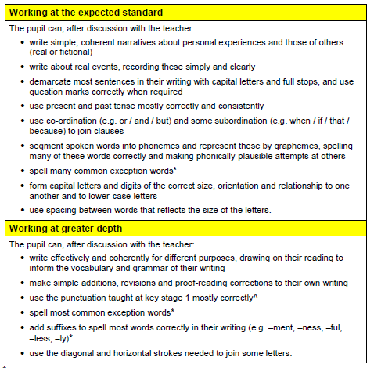
Teacher Assessment Framework for Writing.

Slide 8
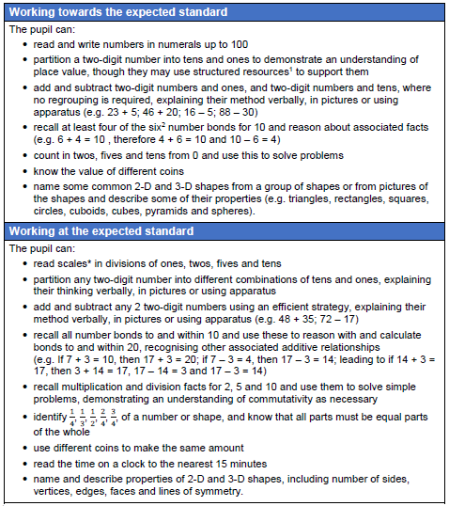
Teacher Assessment Framework for maths.

Slide 9
Teacher Assessment Framework for maths.

Slide 10
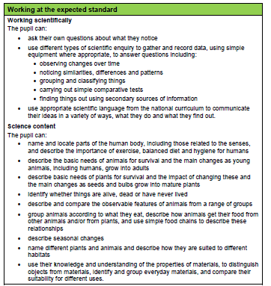
Teacher Assessment Framework for science.

Slide 11
During May
Children will complete 4 booklets:
English reading Paper 1: combined reading prompt and answer booklet
English reading Paper 2: reading booklet and reading answer booklet
Mathematics Paper 1: arithmetic
Mathematics Paper 2: reasoning
Please see examples.
The outcomes support the Teacher Assessment along with all the other evidence gathered throughout thee year.

Slide 12
We Keep it low key and relaxed!
We choose when children complete the booklets – we won’t ask a child to complete a booklet if they come into school worried or upset about something
Children will complete the booklets in small groups with their class teacher (or adults they trust)
No time limit
They don’t have to finish – we will stop them if we feel they have done as much as they can
If necessary, they can have breaks
If necessary, they can have help reading the questions in the maths booklets

Slide 13
How you can help
In May – early nights every night and breakfast every day please! (and yes – you have our permission to quote us to your children on this…)
Let us know of any worries your child shares with you, so that we can reassure them
Reassurance! Remind your child – tests aren’t everything and don’t define them. We’ll be telling them that too! Please remember that WE know that YOUR child is so much more than a test score! ☺

