Slide 1
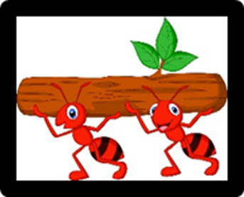
Learning at Home
Award
Reflection
Teamwork
Concentration
Resourcefulness
Curiosity
Perseverance
Presented to
_____________________________
for
_____________________________
_____________________________
_____________________________
Signed_________________
Date________

