Slide 1
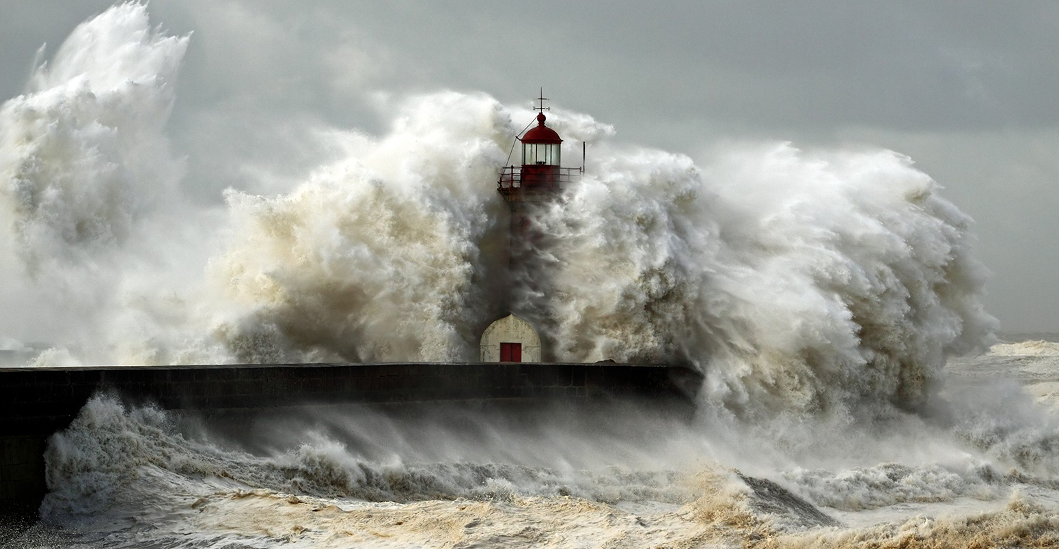

Slide 2
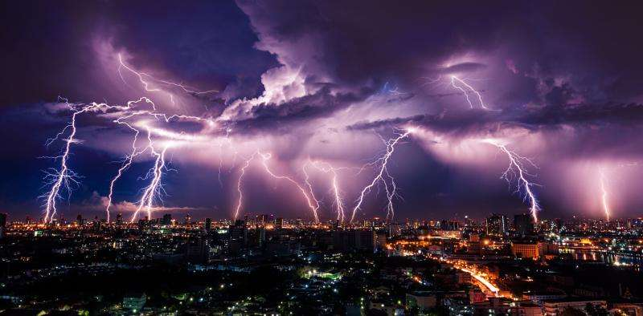

Slide 4
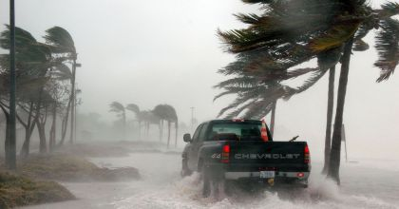

Slide 5
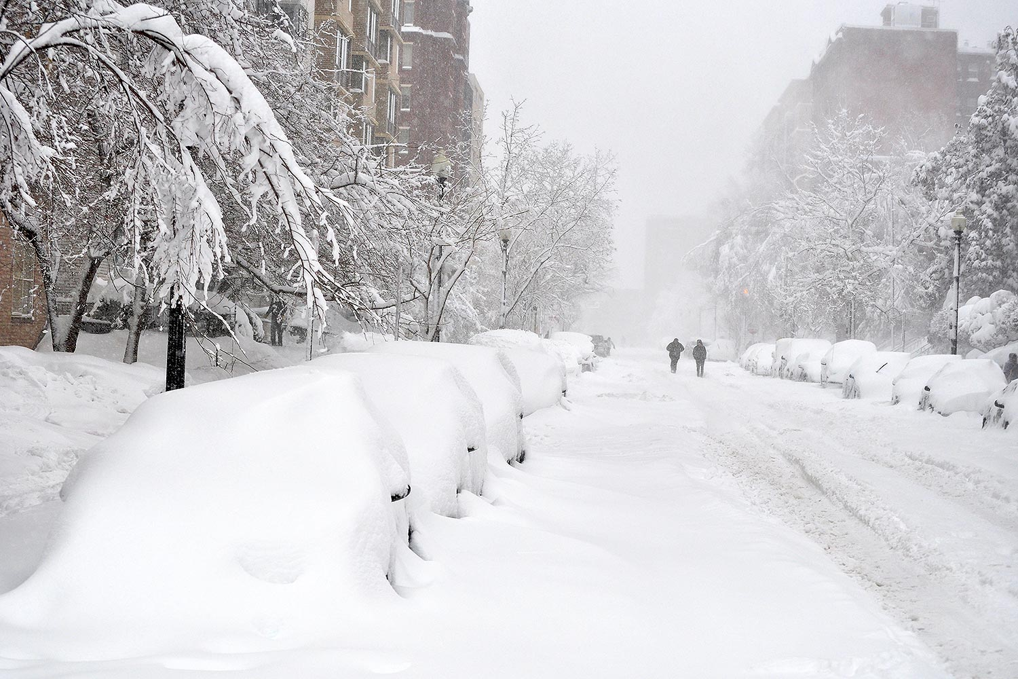

Slide 6
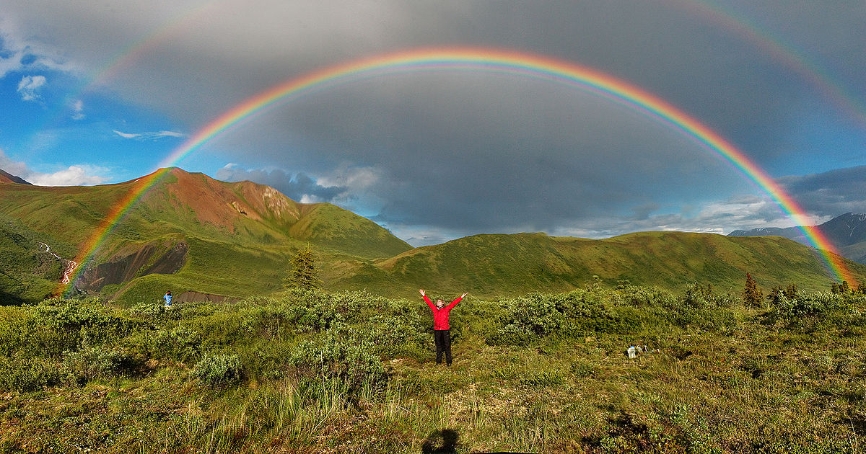

Slide 7
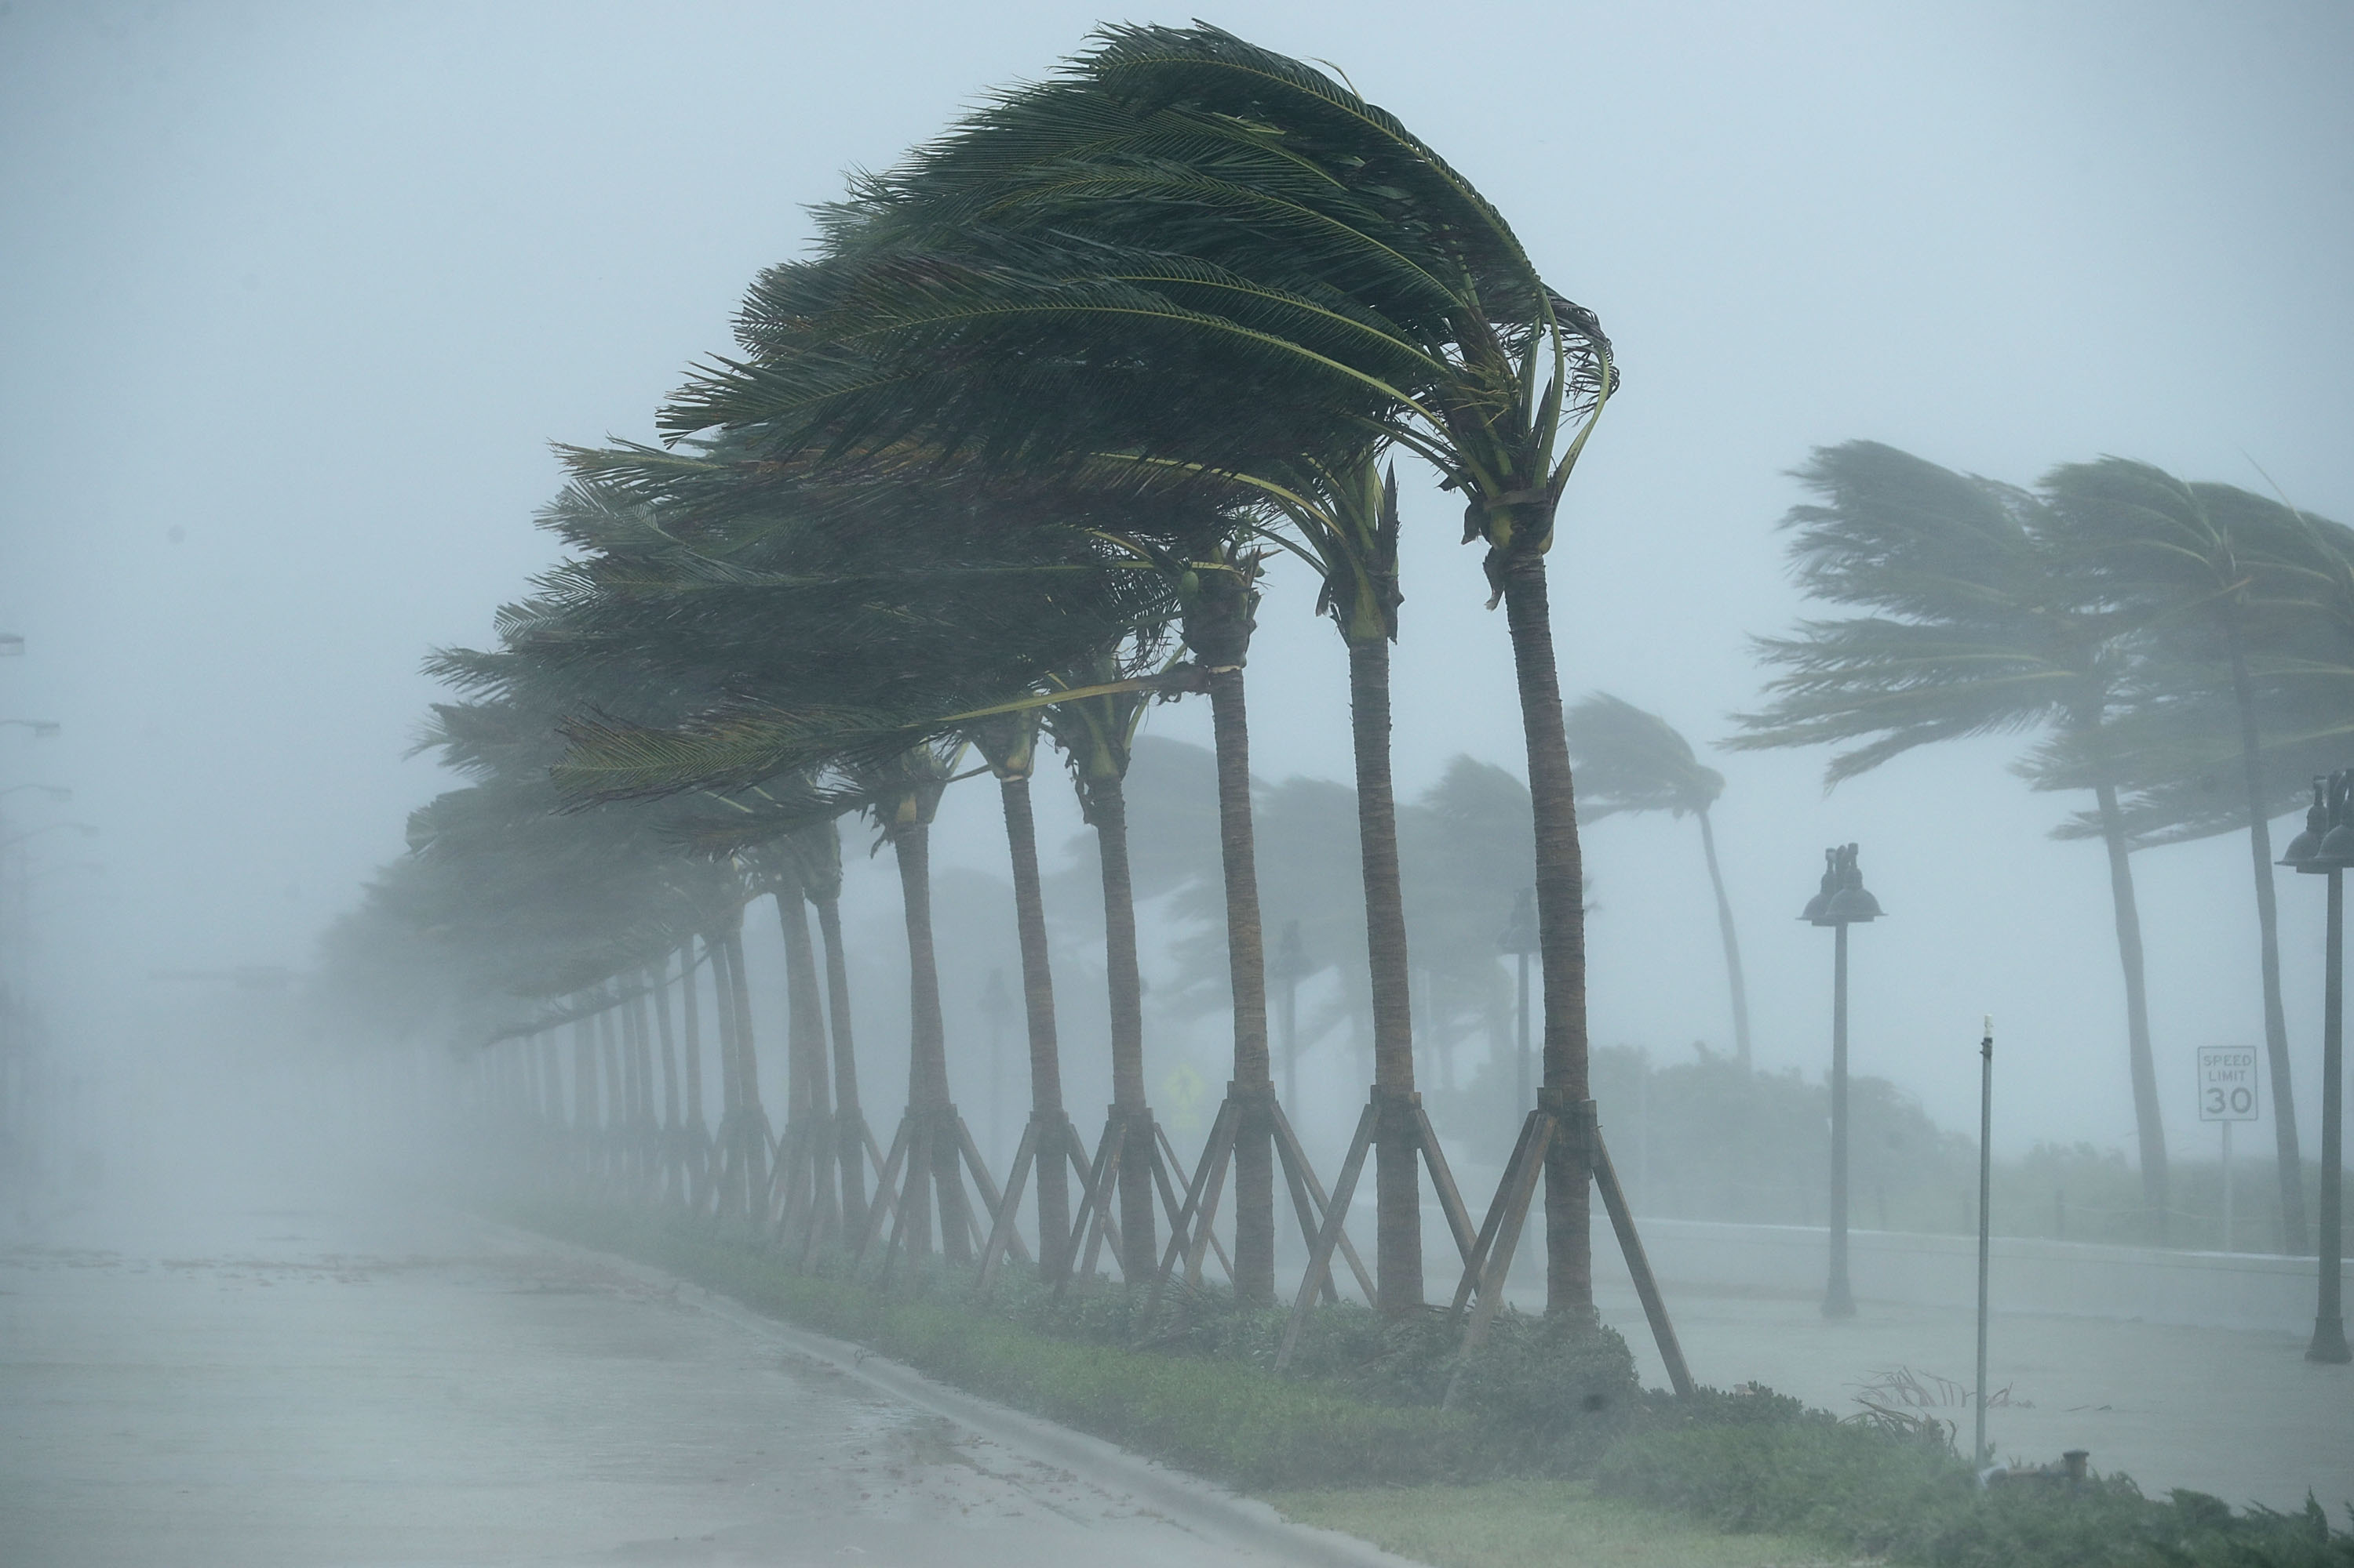

Slide 8
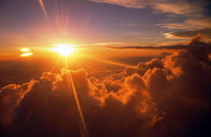

Slide 9
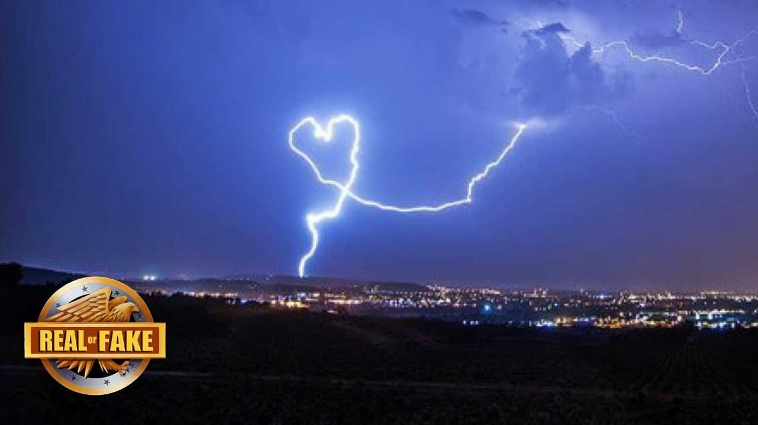

Slide 10
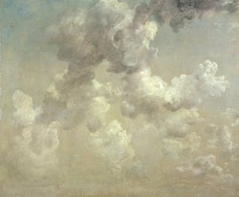
It is never a sunny day in Constable country – there is always a cloud in the sky. But so accurate are these clouds that awed meteorologists can sometimes calculate the season and even the hour from his skies, which Constable famously called "the chief organ of sentiment" in any landscape. Here, the view is Hampstead Heath on a September morning. But what's remarkable is not so much the exactitude of observation as the way Constable's painted shapes materialise on the canvas without resolving into patterns or fixed forms: just like a sky full of clouds.
What pictures do YOU see in clouds?

